Slide 1
Tries

Slide 2
Tries
A trie (from retrieval), is a multi-way tree structure useful for storing strings over an alphabet
An index structure used in variable length keys
It is a decision tree based on a generalization of the binary tree
Trie is a tree of degree m >= 2 in which the branching at any level is determined not by the entire key value, but by only a potion of it

Slide 3
Tries
Common Applications –
  dictionaries
  text searching
  Compression
  Spell checking programs

Slide 4
Tries
The idea is that all strings sharing a common stem or prefix, hang off a common node. When the strings are words over {a..z}, a node has at most 27 children - one for each letter plus a terminator.
The elements in a string can be recovered in a scan from the root to the leaf that ends a string.
All strings in the trie can be recovered by a depth-first scan of the tree.
It is wasteful as a lot of nodes near the edge of the trie will have most sub-tries set to nil.
Lookup is direct as there is random access on each level/character position in a string.

Slide 5
Tries
A second way to implement the trie is to represent each node in the trie as a linked-list of at most 27 elements, each element being a pair <char,trie>.
In this case, a search (linear, binary, ...) must be used at each level but less space is wasted at leaves; remember, in the natural world, trees have more leaves than forks.
Note - The height of a trie is the length of the longest key in the trie.

Slide 6
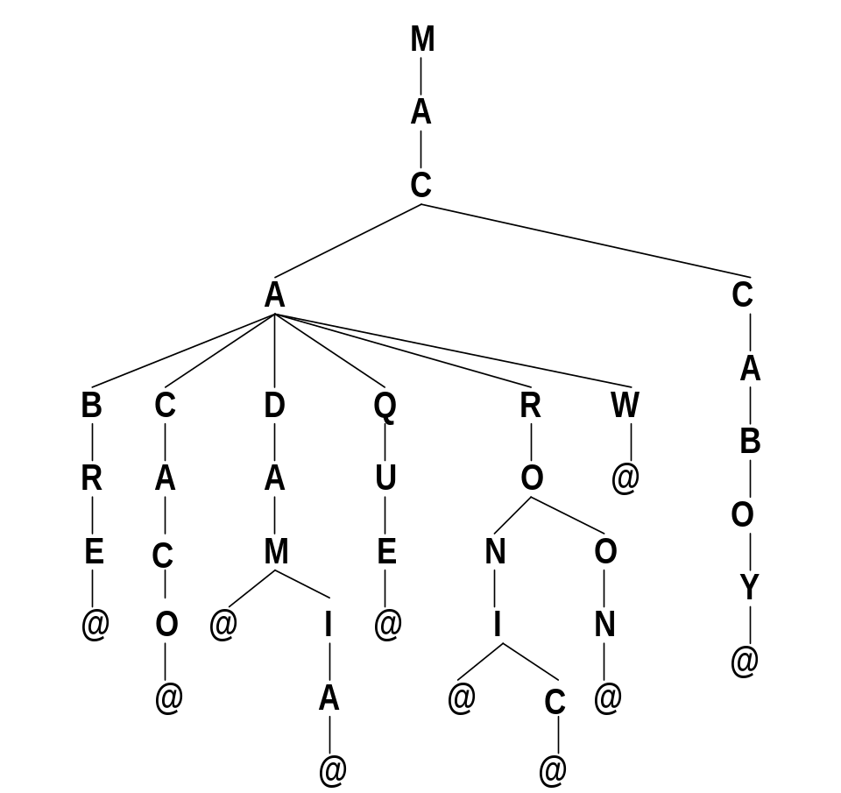
Tries - Example
MACCBOY
MACAW
MACARON
MACARONI
MACARONIC
MACAQUE
MACADAMIA
MACADAM
MACACACO
MACABRE
.
.
.
@ - is the word terminating symbol
as many words as terminating symbols

Slide 7
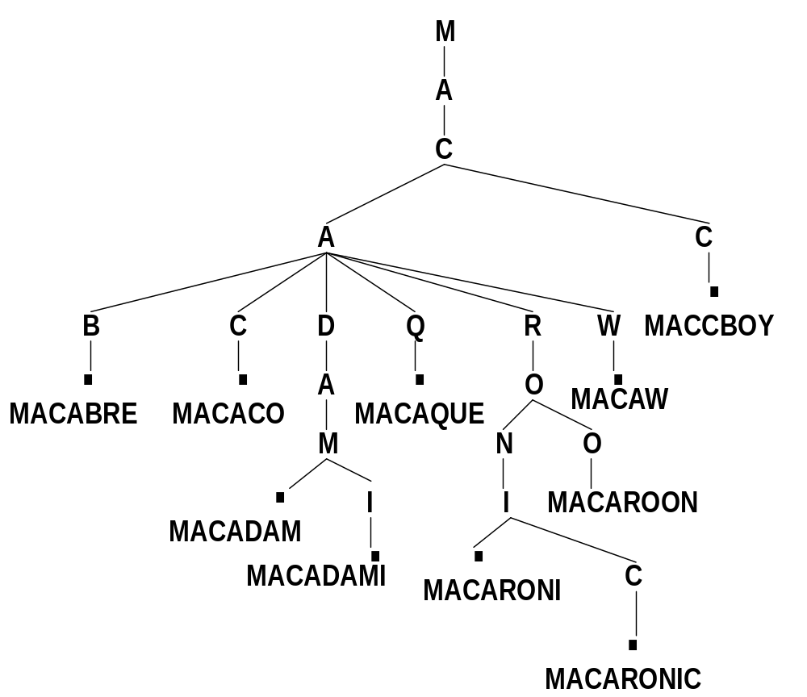
Words are at the Leafs

Slide 8
Preprocessing Strings
Preprocessing the pattern speeds up pattern matching queries
If the text is large, immutable and searched for often we may want to preprocess the text instead of the pattern
A trie is a compact data structure for representing a set of strings, such as all the words in a text
  A tries supports pattern matching queries in time proportional to the pattern size

Slide 9
Standard Tries
The standard trie for a set of strings S is an ordered tree such that:
  Each node but the root is labeled with a character
  The children of a node are alphabetically ordered
  The paths from the external nodes to the root yield the strings of S
Example: standard trie for the set of strings
  S = { bear, bell, bid, bull, buy, sell, stock, stop }

Slide 10
Analysis of Standard Tries
A standard trie uses O(n) space. Operations (find, insert, remove) take time O(dm) each, where:
  n total size of the strings in S
  m size of the string parameter of the operation
  d size of the alphabet

Slide 11
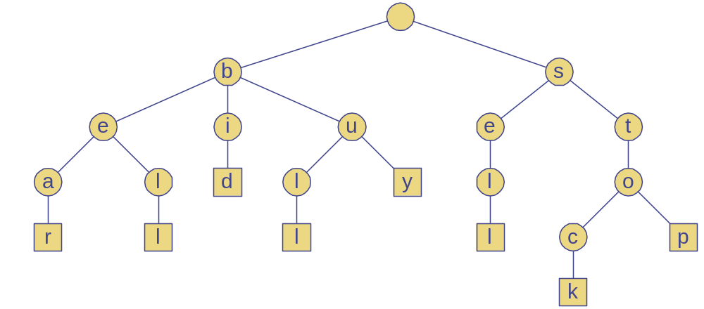
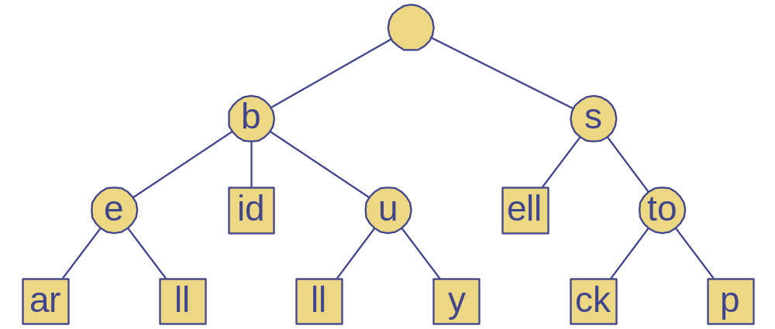
Compressed Tries
A compressed trie has internal nodes of degree at least two
It is obtained from standard trie by compressing chains of “redundant” nodes
  S = { bear, bell, bid, bull, buy, sell, stock, stop }

Slide 12
Example Implementation
A trie can contain two types of nodes: element node, and branch node.
  A element node has only one data member;
  A branch node contains pointers to sub-tries.
Let us assume that each character is one of the 26 letters of the alphabet, a branch node has 27 pointer data member; the extra pointer is used for the blank character which is used to terminate all keys.

Slide 13
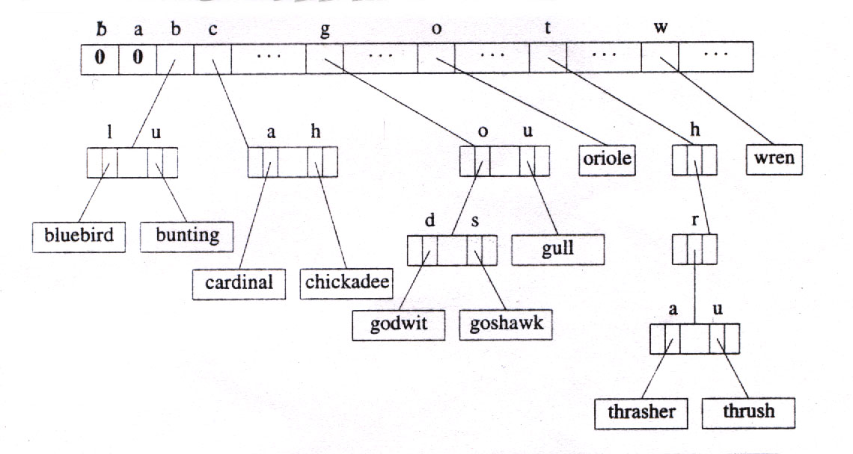

Example Implementation
26 symbols/node => large space overhead

Slide 14
Sampling Strategy
The number of levels in the trie will depend on the strategy or key sampling technique used to determine the branching at each level.
The goal is to make a trie with the fewest number of levels.
The maximum number of levels in a trie can be kept low by adopting a different strategy for element nodes.

Slide 15
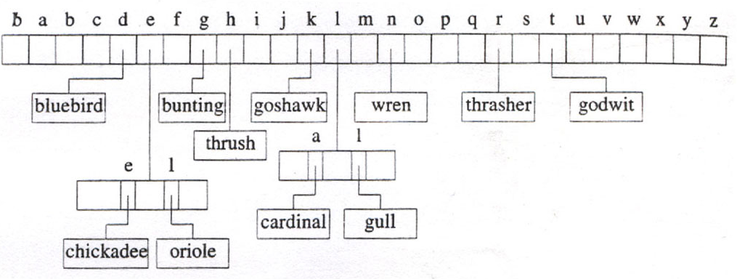
Example Implementation
Trie constructed by sampling one character at a time, from right to left.

Slide 16
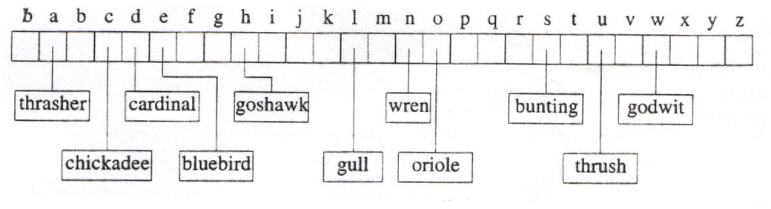
Example Implementation
An optimal trie constructed by sampling on the fourth character of the key values.

Slide 17
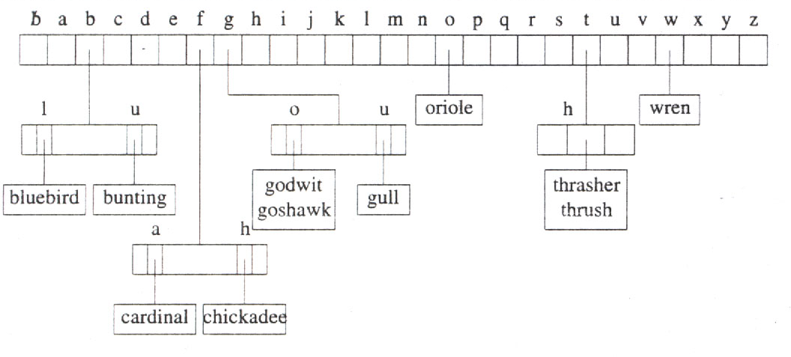
Example Implementation
Number of levels is limited to 3; keys have been sampled from left to right, one character at a time.

Slide 18
Tries - Insertion
Consider the first trie and insert into it the key bluejay.
  Search bluejay, and we find an element node contains bluebird (nearest match).
  The keys bluebird and bluejay are sampled (compared) until the sampling results in two different values. [It happens at fifth letter.]

Slide 19
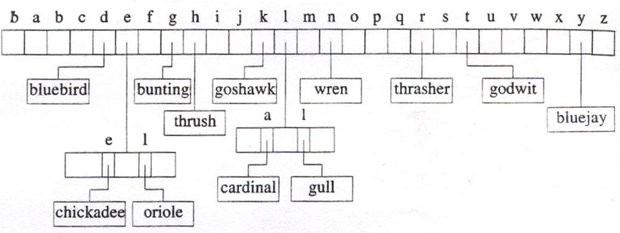
Tries - Insertion
Inserted ‘bluejay’ in the trie constructed by sampling one character at a time, from right to left.
How do we insert ‘bobwhite’ in this trie?

Slide 20
Tries - Deletion
From the previous trie we delete the two added elements.
  First let us delete bluejay. To do this we set
  link[‘y’] = NULL. No other changes need to be made.
  Next we delete bobwhite. To do this we set
  link[‘e’].link[‘t’] = NULL. No other changes need to be made.
HINT - To facilitate deletion from tries, it might be useful to add a count in each branch node.
(This count contains the number of children the node has.)

Slide 21
Tries - Advantages
A trie has a number of advantages,
Looking up data in a trie is faster in the worst case.
There are no collisions of different keys in a trie.
Buckets in a trie are necessary only if a single key is associated with more than one value.
A trie can provide an alphabetical ordering of the entries by key.

Slide 22
Tries - Drawbacks
Tries do have some drawbacks as well,
Some keys, such as floating point numbers, can lead to long chains and prefixes that are not particularly meaningful.
Some tries can require more space than a hash table, as memory may be allocated for each character in the search string, rather than a single chunk of memory for the whole entry, as in most hash tables.
Tries can be slower in some cases than hash tables for looking up data, especially if the data is directly accessed on a hard disk drive or some other secondary storage device where the random-access time is high compared to main memory.

Slide 23
Tries - Applications
Applications of Tries –
Storing a predictive text or autocomplete dictionary in a smart-phone.
Commonly used in implementing approximate matching algorithms like those used in spell checking and hyphenation software.

Slide 24
Tries - Web Search Engines
The index of a search engine (collection of all searchable words) is stored into a compressed trie
Each leaf of the trie is associated with a word and has a list of pages (URLs) containing that word are called occurrence list
The trie is kept in working memory
The occurrence lists are kept in external memory and are ranked by relevance
Boolean queries for sets of words (e.g., Java and coffee) correspond to set operations (e.g., intersection) on the occurrence lists
Additional information retrieval techniques are used, such as
  Stop-word elimination (e.g., ignore “the” “a” “is”)
  Stemming (e.g., identify “add” “adding” “added”)
  Link analysis (recognize authoritative pages)

Slide 25
Tries and Internet Routers
Computers on the internet (hosts) are identified by a unique 32-bit IP (Internet Protocol) address, usually written in “dotted-quad-decimal” notation
An organization uses a subset of IP addresses with the same prefix, e.g., BITS-Goa uses 115.248.*.*, BITS-Pilani 202.78.*.* , BITS-Hyderabad uses 111.93.*.*
A router forwards packets to its neighbors using IP prefix matching rules. E.g., a packet with IP prefix 115.248. should be forwarded to the BITS-Goa gateway router.
Routers use tries on the alphabet 0,1 to do prefix matching.

